Slide 1

DL Approach For Visual Inspection of Casting Products
January - 2024

Slide 2


Agenda
Introduction
Project objective
Background
Methodology
Project Flow
Data Preprocessing
Model Building
Model Evaluation
Conclusion
References

Slide 3

Introduction
Casting inspection is a critical aspect of manufacturing processes, ensuring the quality and reliability of casted components.
The structural integrity of castings directly impacts the performance and safety of various products.
Traditional casting inspection methods have limitations in terms of efficiency and accuracy.
Introduction to leveraging deep learning, specifically Convolutional Neural Networks (CNN), for automated casting inspection.

Slide 4

Objective
The primary objective of the project is to implement a Convolutional Neural Network (CNN) for casting inspection in manufacturing processes.
The project aims to enhance the accuracy and efficiency of defect identification in castings through the application of advanced deep learning techniques.
The specific aim is to address the limitations of traditional casting inspection methods, offering a more reliable and robust solution.

Slide 5
Background
Conventional casting inspection methods have inherent limitations in terms of efficiency and accuracy.
The project explores the potential of deep learning in image recognition tasks for more precise defect identification.
Casting images pose challenges due to their complexity; hence, the importance of Convolutional Neural Networks (CNN) for effective feature extraction.
The structural integrity of castings directly influences the performance and safety of end products.
Introduction of deep learning signifies a paradigm shift towards more advanced and sophisticated techniques in the field of casting inspection.

Slide 6
Methodology
The chosen methodology involves the implementation of a robust Convolutional Neural Network (CNN) architecture tailored for casting inspection.
A comprehensive dataset, representative of diverse casting scenarios, is employed for training and testing the CNN model.
Prior to model training, a series of preprocessing steps are applied to optimize input images, ensuring they are suitable for the CNN model.
The CNN model is designed for efficient feature extraction from complex casting images, enabling accurate defect identification.
The training process includes iterative validation steps to ensure the model's generalization ability and robust performance on new casting data.

Slide 7
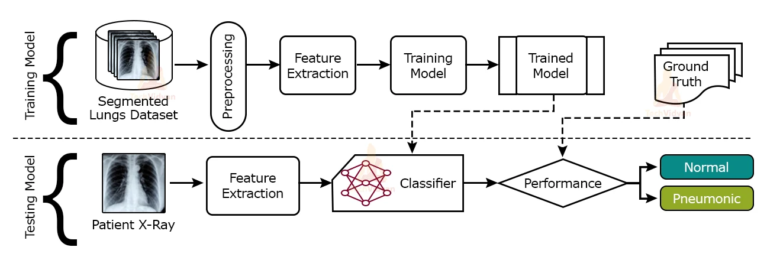
Project Flow
Casting Image
Defective
Non Defective
Casting Image

Slide 8
Data Preprocessing
Normalization: The initial step involves normalizing pixel values from the original range of 0 to 255 to a standardized range of 0 to 1.
This is achieved by utilizing the rescale argument on instances of the Keras ImageDataGenerator for both the train and test sets.
ImageDataGenerator Configuration:
Train Set Configuration: For the train set, the generator is configured with validation_split=0.2, reserving 20% of the data for validation.
Data Flow: The function flow_from_directory() is employed on the data generators for the train and test directories.

Slide 9
Data Preprocessing
Image Specifications:
Target Size: Images are resized to 300×300 pixels.
Color Mode: Images are converted to 'grayscale' to have a single channel.
Class Mapping: Classes are defined as 0 for OK and 1 for Defective.
Class Mode: The class_mode is set to 'binary' since there are two classes.
Batch Size: The batch size is fixed at 64 for efficient training.

Slide 10
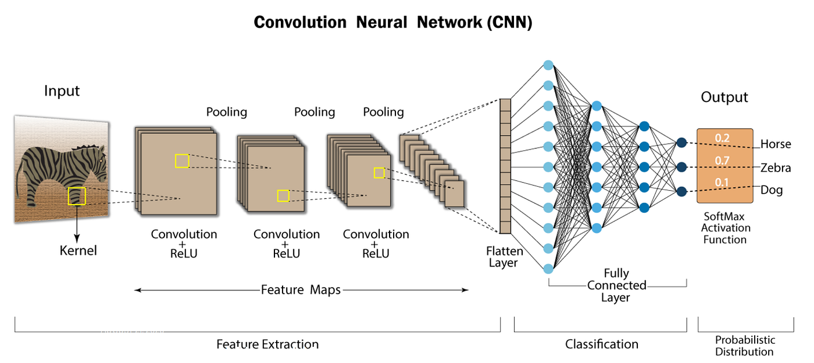
Model Building

Slide 11
Model Building
The goal is to classify castings as either Defective or OK based on provided images, utilizing Convolutional Neural Networks (CNN), widely employed in computer vision applications.
CNN is a deep-learning model specialized in spatial pattern recognition. It comprises convolutional layers, pooling layers, and a final fully-connected layer, extracting features like shape and color patterns from pixel values.
The model architecture draws inspiration from VGG models, stacking convolutional layers with 3×3 filters, followed by max pooling layers. The blocks are repeated with an increasing number of filters (e.g., 32, 64, 120, 256).
Padding ensures consistency in height and width between input and output. ReLU activation is applied to every layer except the last one. The output layer has 1 node and a sigmoid activation function for binary classification.

Slide 12
Model Building
The model is trained using the Adam optimizer with a learning rate of 0.001 and binary cross-entropy loss function. Accuracy is the metric monitored during training.

Slide 13
Model Evaluation
Training Duration: The model is trained for 20 epochs, representing complete passes through the entire training dataset.
Batch Processing: Each epoch requires 83 steps for all image batches to pass through the network, facilitating comprehensive learning.
ModelCheckpoint Callback: The ModelCheckpoint callback is employed to save the model at an epoch where the validation loss (val_loss) is minimized, ensuring the preservation of the best-performing model.
Performance Monitoring: The choice to save based on val_loss signifies a focus on minimizing validation loss, indicative of the model's ability to generalize well to new, unseen data.
Future Predictions: The saved model will later be loaded to make predictions on the test set, providing insights into the model's performance on new, previously unseen casting images.

Slide 14
Conclusion
Accuracy Improvement: The model's accuracies generally increase, and the loss decreases with each epoch during training.
Alignment of Curves: Notably, the training and validation curves closely align, indicating that the model doesn't overfit and is likely to perform well on the test set.
Best Performance at Epoch 20:
Training Accuracy: Achieved a remarkable 99.57% training accuracy.
Validation Accuracy: Demonstrated a high 98.19% validation accuracy.

Slide 15
References
Kaggle:https://www.kaggle.com/datasets/ravirajsinh45/real-life-industrial-dataset-of-casting-product?rvi=1
Technical paper: Transfer Learning for Detection of Casting Defects Model In Scope of Industrial 4.0 https://dergipark.org.tr/en/download/article-file/2896728#:~:text=Deep%20learning%20algorithms%20can%20analyze,detect%20defects%20in%20real%2Dtime.

